Slide 1
Which sector has the highest number of companies
Most companies belong to the Consumer and Discretionary Sector

Slide 2
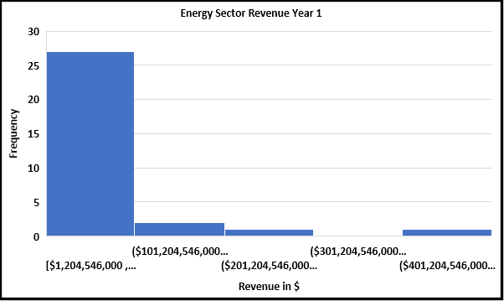
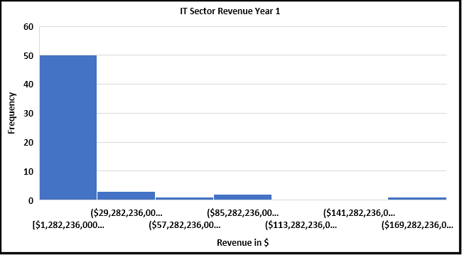
Do companies in Energy Sector make more Revenue than IT Sector During Year 1 of operation?
The histograms above show Year 1 Revenues for Energy and IT Sectors Respectively. Both are right skewed, meaning that the average(mean) revenue is greater than the median

Slide 4
How does the gross profit of the Real Estate Sector vary across the years
The line chart alongside shows us how the gross profit for the real estate sector has been evolving between 2012 and 2016.
There has been an upward trend( increase)in the average gross profit for the Real estate sector

